Slide 1
Real Estate Valuation
Shengyang Ni

Slide 2
Introduction
The project aims to predict the house price of unit area in New Taipei City, Taiwan.
Three datasets are given in this project: training features, training labels, test features
Feature datasets contain the input variables and label dataset contains the output variable

Slide 3
Attribute Information
Input
X1=the transaction date (for example, 2013.250=2013 March, 2013.500=2013 June, etc.)
X2=the house age (unit: year)
X3=the distance to the nearest MRT station (unit: meter)
X4=the number of convenience stores in the living circle on foot (integer)
X5=the geographic coordinate, latitude. (unit: degree)
X6=the geographic coordinate, longitude. (unit: degree)
Output
Y= house price of unit area (10000 New Taiwan Dollar/Ping, where Ping is a local unit, 1 Ping = 3.3 meter squared)

Slide 4
Methodology
STEP 1
STEP 2
STEP 3
Data exploration.
K-means cluster
Remove outlier
Correlation plot
Data cleansing
Regression models.
Data preparation
Linear regression
Gradient boosting
Random forest
Model selection.
RMSE
Final score

Slide 5
Training features and labels
 | trans date | house age | distance mrt | stores | latitude | longitude | house price
0 | 2013.5 | 26.4 | 335.5273 | 6 | 24.9796 | 121.5414 | 38.1
1 | 2013.4166667 | 6.4 | 90.45606 | 9 | 24.97433 | 121.5431 | 59.5
2 | 2013.3333333 | 3.9 | 49.66105 | 8 | 24.95836 | 121.53756 | 56.8
3 | 2013.5 | 23.0 | 3947.945 | 0 | 24.94783 | 121.50243 | 25.3
4 | 2013.3333333 | 39.7 | 333.3679 | 9 | 24.98016 | 121.53932 | 32.4

Slide 6
K-means clustering
The data collected from Sindian Dist., New Taipei City, Taiwan.
Geographic coordinate is not far from each other
Small variation in longitude and latitude can affect largely on house price
from sklearn.cluster import Kmeans
from scipy.spatial.distance import
cdist, pdist
X = pd.concat([training, testing],axis = 0)
X = X[['latitude', 'longitude']].values
Ks = range(1, 10)
kmean = [KMeans(n_clusters=i).fit(X) for i in Ks]
kmeans = KMeans(n_clusters=4)
kmeans.fit(X)

Slide 7
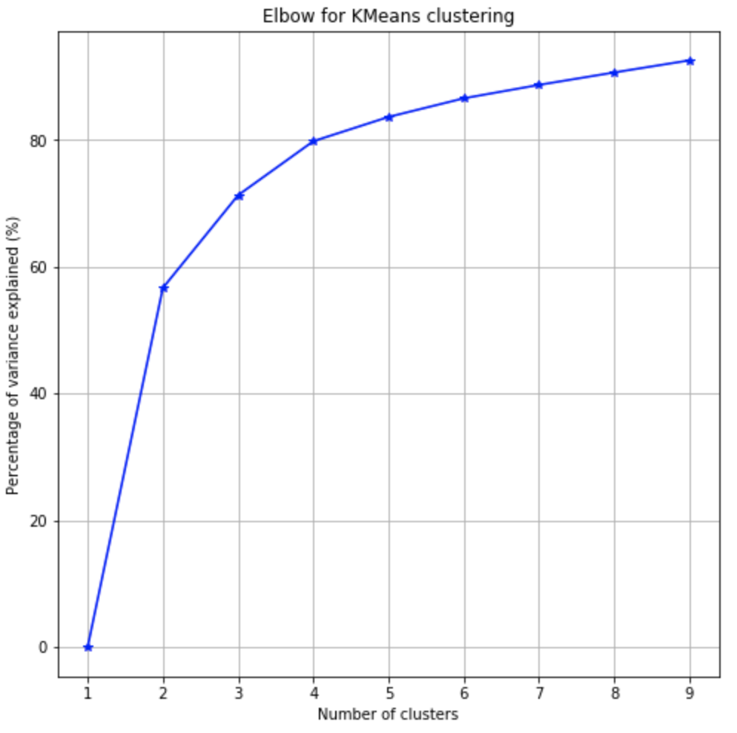
Elbow method
def plot_elbow(kmean, X):
centroids = [k.cluster_centers_ for k in kmean]
D_k = [cdist(X, center, 'euclidean') for center in centroids]
dist = [np.min(D,axis=1) for D in D_k]
wcss = [sum(d**2) for d in dist]
tss = sum(pdist(X)**2)/X.shape[0]
bss = tss-wcss
plt.subplots(nrows=1, ncols=1, figsize=(8,8))
ax = plt.subplot(1, 1, 1)
ax.plot(Ks, bss/tss*100, 'b*-')
plt.grid(True)
plt.xlabel('Number of clusters')
plt.ylabel('Percentage of variance explained (%)')
plt.title('Elbow for KMeans clustering')
plt.show()
plot_elbow(kmean, X)

Slide 8
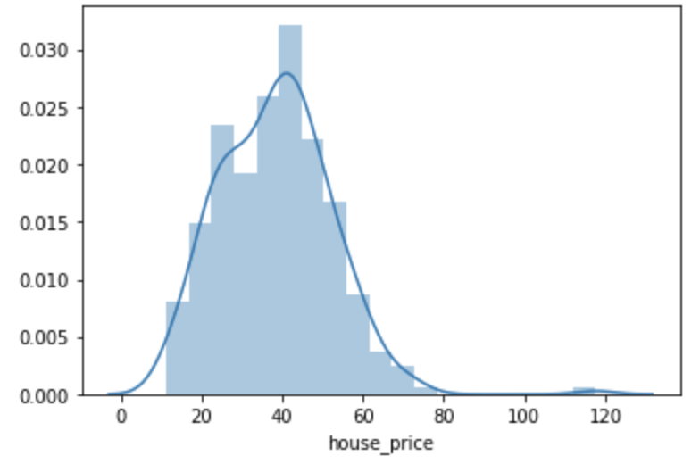
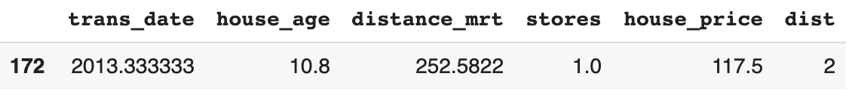
House Price
df['house_price'].describe()
count 289.000000
mean 38.333218
std 13.824176
min 11.200000
25% 27.700000
50% 38.600000
75% 47.100000
max 117.500000
Name: house_price, dtype: float64
df.sort_values('house_price').tail(1)

Slide 9
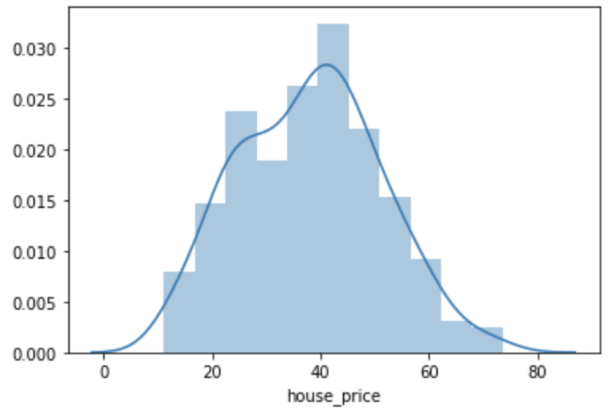
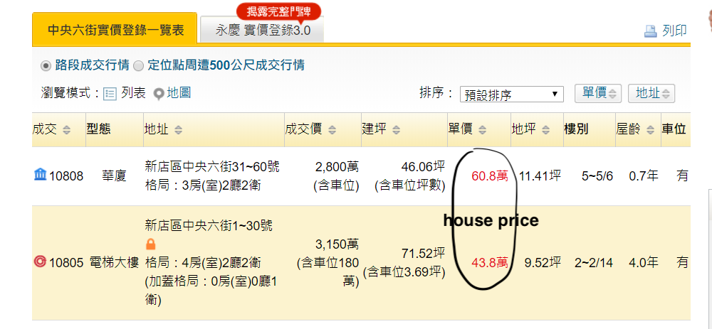
Remove the outlier
df = df.drop(172, axis = 0)

Slide 10
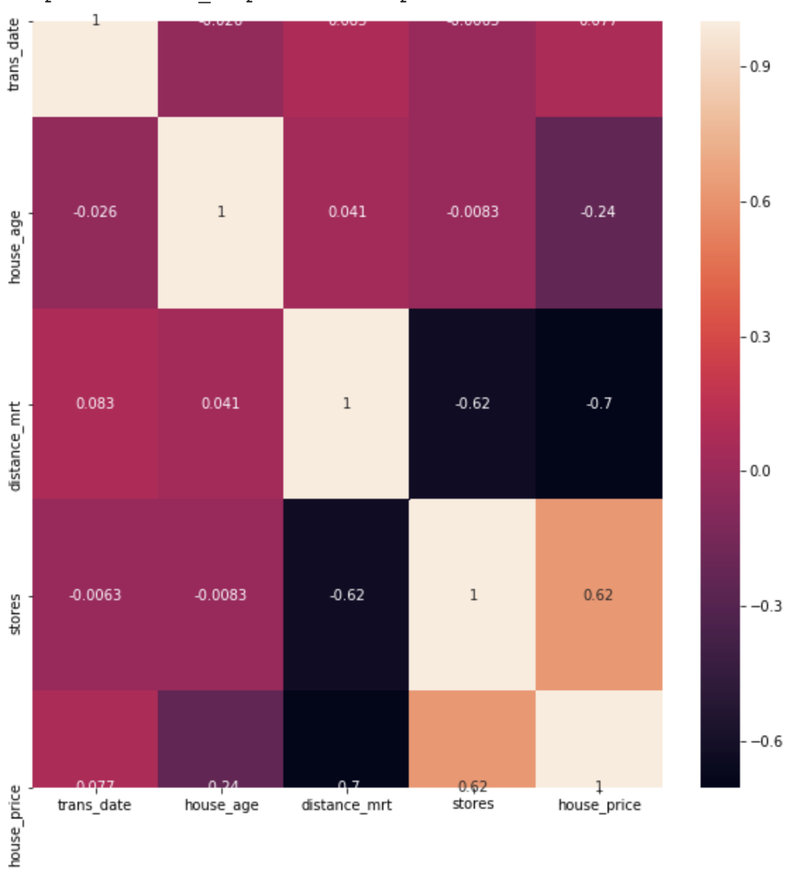
Correlation matrix
%matplotlib inline
corr = df.iloc[:,:-1].corr()
plt.figure(figsize=(10, 10))
sns.heatmap(corr,annot = True,
xticklabels=corr.columns,
yticklabels=corr.columns)

Slide 11
Transaction date
df['trans_date'].describe()
Remove the variable
Because the transaction date spreads only in a year, which affects less on house price
count 288.000000
mean 2013.149016
std 0.282665
min 2012.666667
25% 2012.916667
50% 2013.166667
75% 2013.416667
max 2013.583333
Name: trans_date, dtype: float64

Slide 12
Data cleansing
Drop the latitude and longitude variables
Add a new variable for k-means clustering named ‘dist’
Remove transaction date variable
Do the same for test features.
dff = pd.concat((training, pd.DataFrame(kmeans.labels_)),
axis=1)
dff = dff.drop(["latitude","longitude"],axis = 1)
dff.columns = [‘trans_date','house_age','distance_mrt','stores','house_price','dist']
df = dff.iloc[:289,:]
df.info()
Data columns (total 5 columns):
house_age float64 distance_mrt float64
stores int64
house_price float64
dist float64
df = df.drop('trans_date',axis = 1)

Slide 13
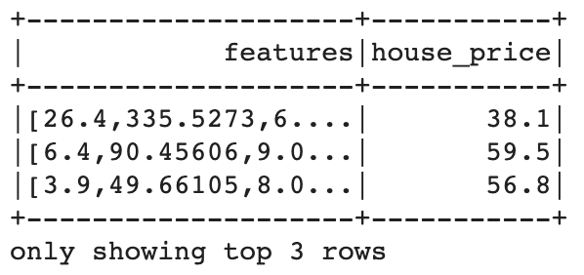
Data preparation
df = spark.createDataFrame(df)
from pyspark.ml.feature import VectorAssembler
vectorAssembler = VectorAssembler(inputCols = ['house_age', 'distance_mrt', 'stores', 'dist'], outputCol = 'features')
vhouse_df = vectorAssembler.transform(df)
vhouse_df = vhouse_df.select(['features', 'house_price'])
splits = vhouse_df.randomSplit([0.7, 0.3])
train_df = splits[0]
test_df = splits[1]

Slide 14
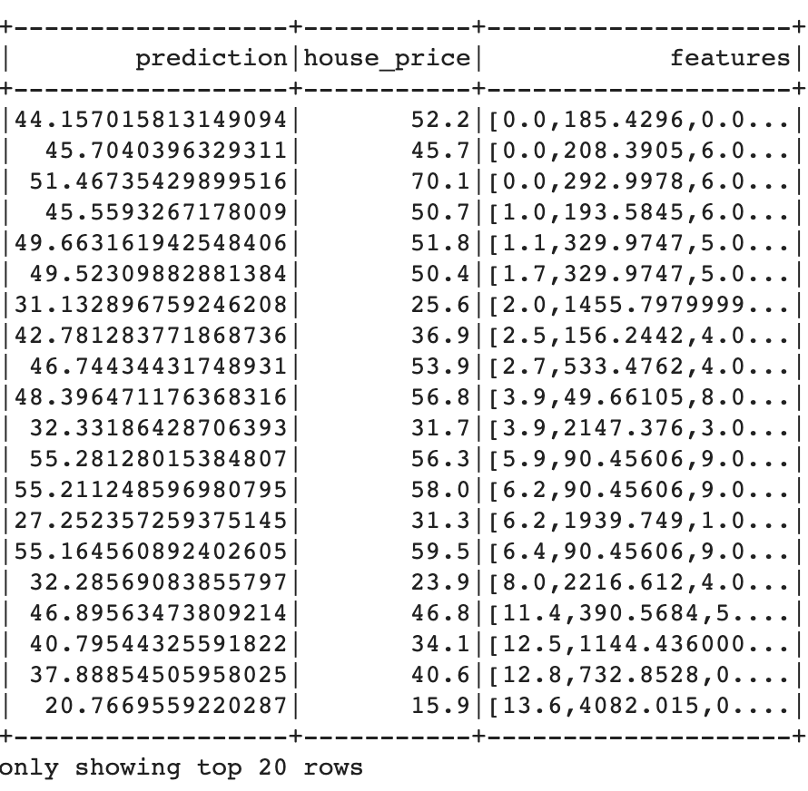
Linear regression
RMSE on train data: 7.443968
RMSE on test data = 7.66188
from pyspark.ml.regression import LinearRegression
from pyspark.ml.evaluation import RegressionEvaluator
lr = LinearRegression(featuresCol = 'features', labelCol='house_price', maxIter=10, regParam=0.3, elasticNetParam=0.8)
lr_model = lr.fit(train_df)
trainingSummary = lr_model.summary
print("RMSE on train data: %f" % trainingSummary.rootMeanSquaredError)
lr_predictions = lr_model.transform(test_df)
lr_evaluator = RegressionEvaluator(predictionCol="prediction", \
labelCol="house_price",metricName="r2")
test_result = lr_model.evaluate(test_df)
print("RMSE on test data = %g" % test_result.rootMeanSquaredError)
predictions = lr_model.transform(test_df)
predictions.select("prediction","house_price","features").show()

Slide 15
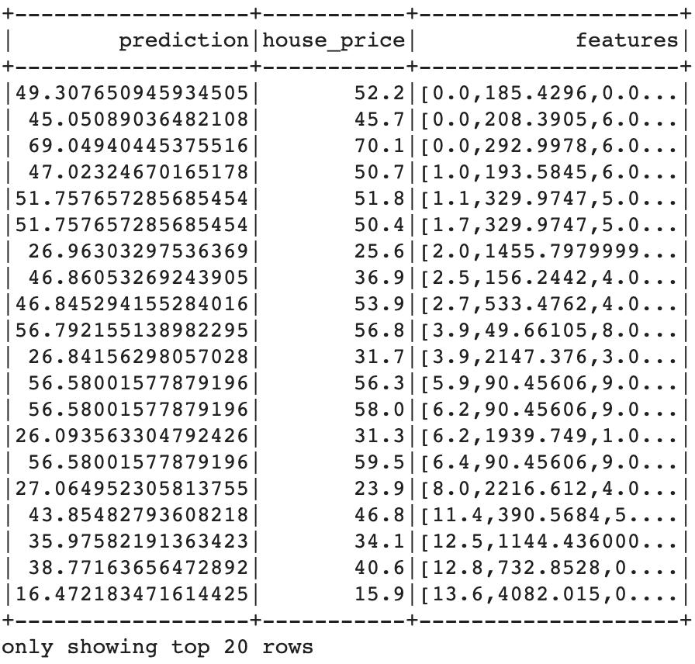
Gradient boosting
RMSE on train data: 3.55809
RMSE on test data = 6.62987
from pyspark.ml.regression import GBTRegressor
gbt = GBTRegressor(featuresCol = 'features', labelCol = 'house_price', maxIter=10)
gbt_model = gbt.fit(train_df)
gbt_evaluator = RegressionEvaluator(
labelCol="house_price", predictionCol="prediction", metricName="rmse")
training_result = gbt_evaluator.evaluate(gbt_model.transform(train_df))
gbt_predictions = gbt_model.transform(test_df)
rmse = gbt_evaluator.evaluate(gbt_predictions)
print("Root Mean Squared Error (RMSE) on train data = %g" % training_result)
print("Root Mean Squared Error (RMSE) on test data = %g" % rmse)
predictions = gbt_model.transform(test_df)
predictions.select("prediction","house_price","features").show()

Slide 16
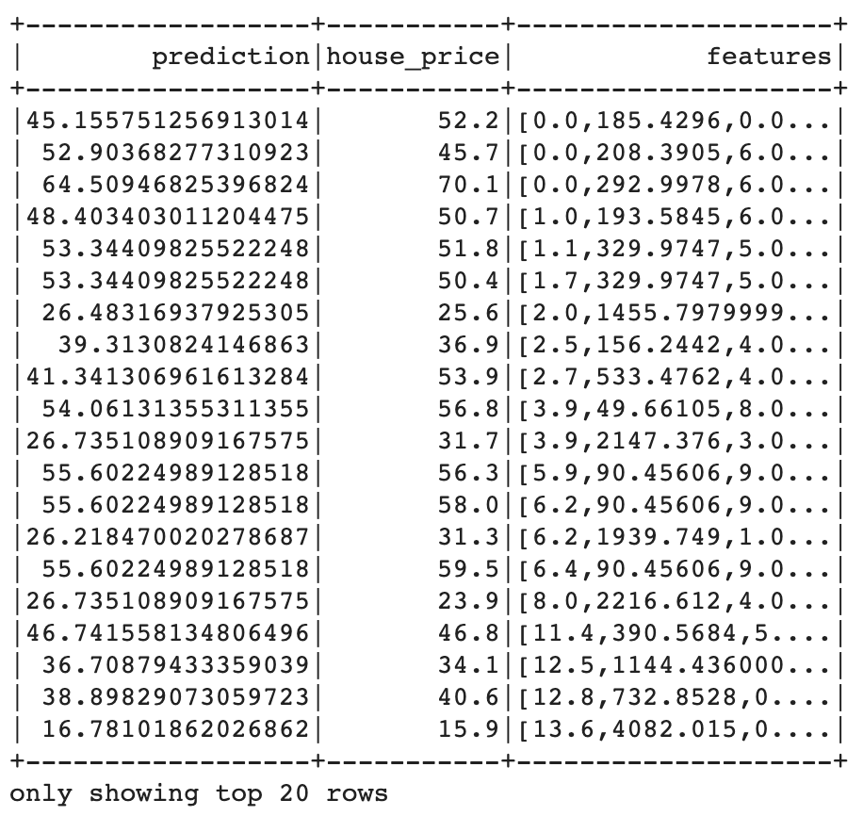
Random Forest
RMSE on train data: 4.59878
RMSE on test data = 6.1514
from pyspark.ml.regression import RandomForestRegressor
rf = RandomForestRegressor(featuresCol ='features', labelCol = 'house_price')
rf_model = rf.fit(train_df)
rf_evaluator = RegressionEvaluator(
labelCol="house_price", predictionCol="prediction", metricName="rmse")
training_result = rf_evaluator.evaluate(rf_model.transform(train_df))
testing_result = rf_evaluator.evaluate(rf_model.transform(test_df))
print("Root Mean Squared Error (RMSE) on train data = %g" % training_result)
print("Root Mean Squared Error (RMSE) on test data = %g" % testing_result)
predictions = rf_model.transform(test_df)
predictions.select("prediction","house_price","features").show()

Slide 17
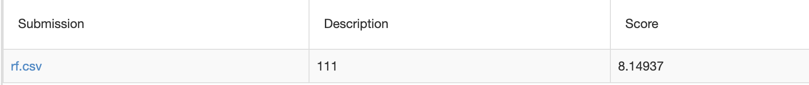
Model selection
Random forest has the lowest RMSE in test samples among three model predictions
Use random forest model with test dataset
Final scores: 8.14937

Slide 18
Thank you

